Slide 1
Lan Utility
CSE323 – Computer Networks
B1 Slot – Prof. Jagadessh Kannan. R

Slide 2
Team Members:
D. Shashank – 13BCE1036
Harshwardhan Agarwal – 13BCE1052
K. Gourav - 13BCE1068
S. Nikesh Kumar Reddy – 13BCE1136

Slide 3
Abstract
A LAN Utility is a software / application which is used for the establishment of connection between two or more people/systems by just connecting to the same network without any internet access. This type of utility enable people to connect and exchange information easily.

Slide 4
Introduction
Implementation of LAN messenger now a days is a simple task which is made easier through socket programming followed by instant messaging (IM).
Not only a messenger but also a lot more applications are possible through LAN.
Digitalization is one major aspect in which India is very much lagging behind. This digitalization should be one of the key aspects on which both government and society should concentrate upon.
This LAN utility enables digitalization in education as: for example, a lecturer wants to give a lecture, if every student and the lecturer are connected to the same network, this utility works in such a way that whatever the lecturer wants to convey through writing it on the board, if he writes it on his screen, it would reflect on every system and if any one of the students want to send some information, it would be shared with all.

Slide 5
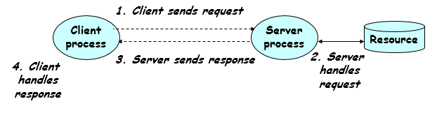
Client – Server mechanism
Socket Programming going hand in hand with client server mechanism gives the maximum through put to have a distinguished result.

Slide 6
Client – Server mechanism
Client asks (request) – server provides (response). Typically a single server handles multiple clients but there can even be multiple servers handling multiple clients depending upon the number of clients and system resources.
The server does not need to know anything about the client even that it exists but the client should always know something about the server at least where it is located.
Clients and servers are processes running on network hosts i.e. they have to connect to a particular network (need not have internet access). They may be on the same host to be connected to each other for better transmission.

Slide 7
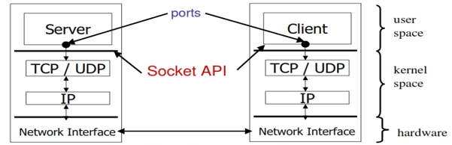
Client – Server mechanism
Sockets are used for inter process communication. Most of the inter-process communication follow a Client – Server model where client and server are two different processes. Server and Client exchange messages over the network through a common socket API.

Slide 8
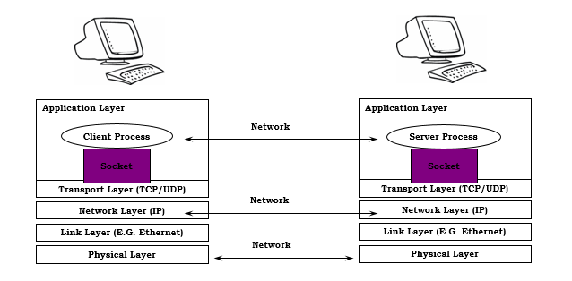
Client – Server mechanism
The network interface is provided by the operating system in this way.

Slide 9
Client – Server mechanism
The IP address in the server socket address identifies the host
The (well-known) port in the server socket address identifies the service, and thus implicitly identifies the server process that performs that service.
Examples of well-known ports:
Port 7: Echo server
Port 23: Telnet server
Port 25: Mail server
Port 80: Web server

Slide 10
Client – Server mechanism
Servers are long-running processes (daemons). Created at boot-time (typically) by the INIT process (process 1). Run continuously until the machine is turned off. Each server waits for requests to arrive on a well-known port associated with a particular service. Other applications should choose between 1024 and 65535.

Slide 11
Client – Server mechanism
To the kernel, a socket is an endpoint of communication. To an application, a socket is a file descriptor that lets the application read/write from/to the network. All Unix I/O devices, including networks, are modeled as files. Clients and servers communicate with each by reading from and writing to socket descriptors. The main distinction between regular file I/O and socket I/O is how the application “opens” the socket descriptors.

Slide 12
Modules
The whole process has been divided into three modules. They are:
Messaging Module
GUI Module
Utility Module

Slide 13
Messaging module
As already explained, LAN messenger is made using TCP chat application. These are some of the steps involved in TCP protocol.
Server:
Step 1: Creating Socket
Step 2: Binding the socket with the system and port as information exchange channel.
Step 3: Listen to any connection requests being received to the server from any client.
Step 4: Accept the connection.
Step 5: Perform the actions requested by the client or ask the client to perform your desired actions. Actions here mean exchange of information (LAN Messenger)
Step 6: Close the socket.

Slide 14
Messaging module
Client:
Step 1: Create the socket
Step 2: Request connection to the server.
Step 3: Exchange information with the server once the connection is established.
Step 4: Close the socket.

Slide 15
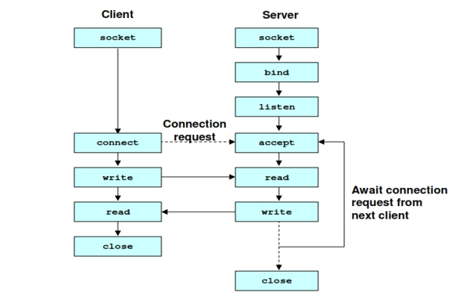

Slide 16
GUI module
Graphical user interface plays an important and one of the major roles in any application. Impression of the user is one basic aspect in which a developer/programmer should not override his thoughts and provide an impressive GUI for a utility to have its votes.

Slide 17
Utility module
To decide such a utility in a comprehensive manner, JAVA has been used to code the board module of the utility. Pen tip size, pseudo color configuration (214 combinations of RGB colors) and some other utilities have been added into the code and a flawless application/utility has been prepared.

Slide 18
References
www.wikipedia.com
Code done by us.

Slide 19
Thank You

